Slide 1
Introduction to Tabular Editor
Simon Nuss
Director, Data & Analytics
OMERS

Slide 2
Goals
Where Tabular Editor fits into the Power BI landscape
Guidance on key features and various use-cases
Tips & tricks for how to get started
Links to resources

Slide 3
Agenda
What is Tabular Editor?
Under the hood
Demo
Getting started with Tabular Editor

Slide 4
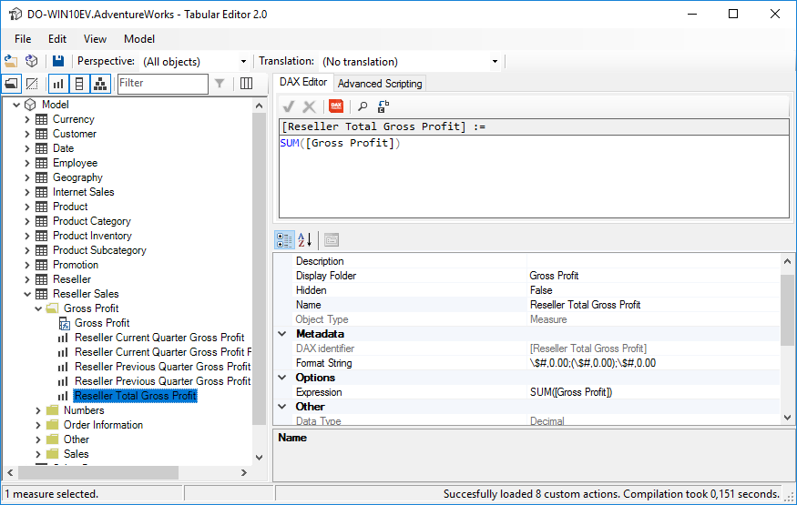
What is Tabular Editor?
Load existing dataset
Manage, develop, debug
Unit Test
Deploy
Repeat
Tabular Editor is a free authoring tool for Power BI Service datasets, Power BI Template Files, and SSAS Tabular models.
Notes:
What is Tabular Editor?
A free 3rd party application for Power BI professionals
It plugs gaps Power BI’s dataset modeling capabilities
Other tools: DAX Studio, Power BI Helper, VertiPaq Analyzer, BISM Normalizer, BIDS Helper etc.
Click:
Explain process
Who’s heard of DAX Studio?
DAX Studio reads data from a dataset
Tabular Editor edits a datasets metadata

Slide 5
What is Tabular Editor? Recap
Data Flows
Datasets
Visuals
Power BI
Tabular Editor

Slide 6
Under the hood
Tabular Editor uses the Tabular Object Model (TOM) to load settings from/to a Power BI dataset model.bim file
TOM exposes all dataset metadata such tables, columns, measures, relationships etc.
TOM uses the XMLA protocol
Why does XMLA sound so familiar….
Editing Power BI files is not supported by Microsoft and may corrupt your .pbix file. Proceed at your own risk!

Slide 7
DEMO
Notes:
Lesson 1: Be careful
Open PBIX
Report
Measures
Data Model
Save PBIX as PBIT
Open PBIT
GUI layout:
Navigation tree
‘Sales’[Sum of Sales] “Expression Editor”
Settings pane down the bottom
DAX Formatter
Change Name to “Summation of Sales” 💡 Child dependencies will automatically update just like Power BI
Edit -> Show History
Save & load PBIT 💡 Changes will be saved directly to a live Tabular dataset. Tabular Editor will alert you of any changes have occurred since you loaded the dataset.
Fix broken report
💡 Tabular Editor is client tool agnostic, i.e., it is ONLY concerned with the dataset
💡 It is very easy to break things
Lesson 2: Efficiencies
Save PBIX as PBIT
Open PBIT
Find/replace “Product” with “_Product”. CTRL+A + F2
Change relationships to “One Direction” 💡 Hidden features such as “Join on Date Behavior”
Tools -> Best Practice Analyzer
Tools -> Manage BPA Rules -> Add -> Include Rule File from URL: “https://raw.githubusercontent.com/TabularEditor/BestPracticeRules/master/BPARules-standard.json”
Click “55 BP issues” link at footer 💡 You can create your own custom rules
Open up “DAX Date Template.pbit”
Copy/paste ‘Date’ 💡 Powerful feature
Paste ‘Date’ into Notepad. Enable mouse auto-scroll. Drop mic
Right-click [Sum of Sales] -> Show Dependencies
Lesson 3: Advanced Stuff
Advanced Scripting:
Model.Tables["Sales"].Measures["Sum of Sales"].DisplayFolder = "New Folder";
Samples -> Tutorials -> Loop through all selected columns 💡 Tabular Editor adds helper functionality to the TOM tree, e.g., the AllMeasures property and Output() or ReadFile() methods, e.g., Model.AllMeasures.Count().Output();
Automatically clean an entire model’s measures: Selected.Measures .Where(m => m.Name.Contains("Sum of")) .ForEach(m => m.Expression = FormatDax(m.Expression));
Custom Actions. Show YTD measure.
Model testing and deployment can be fully automated using command line parameters:
CD "C:\Program Files (x86)\Tabular Editor\”
start /wait TabularEditor.exe /?
Advanced scenarios:
Automated model deployments between DEV, UAT, PROD
Automated unit testing
Azure DevOps command line integration
Automated documentation
Import/Export of data and integration with other tools
Generate measures from a file
Automated model cleaning
SQLBI’s Dump Filters measure: https://github.com/otykier/TabularEditor/wiki/Useful-script-snippets#create-dumpfilters-measure
Dependency analysis in large models

Slide 8
It is easy to get started! Download for free at github.com/otykier/TabularEditor
Updated regularly by Daniel Otykier
Streamlined for no-code/low-code development
Begin with the Getting Started wiki
Great documentation
Watch Boosting SSAS Producitivity with Tabular Editor for a deep-dive
Setup tables and relationships using Power BI as normal. Use Tabular Editor to do the rest!

Slide 9
Questions?

Slide 10

Please fill out the survey to win swag!
https://www.powerplatformbootcamp.com/survey

Slide 11
Thank You For Attending

